Slide 1

Modeling message-based systems

Slide 2

Agenda
Why message-based systems?
What is system modelling?
How to model a system?
Types of message-based systems

Slide 3

Why message-based systems?

Slide 4
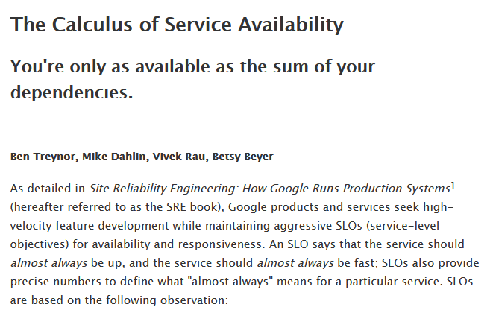
The Calculos of Service Availability
A service cannot be more available than the intersection of all its critical dependencies.

Slide 5
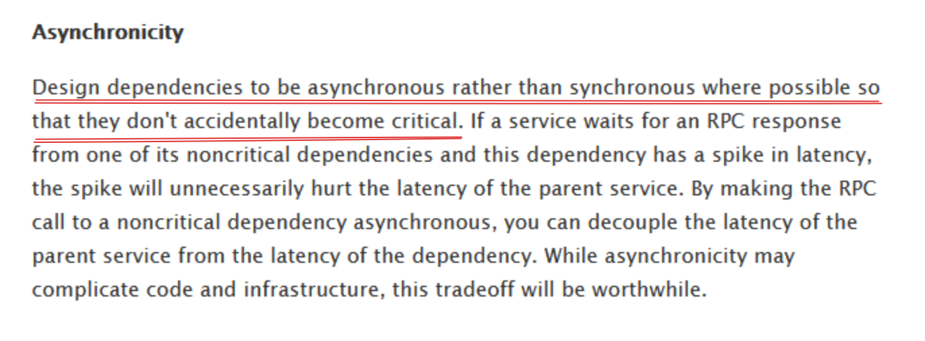
Solution? Asynchronicity!

Slide 6
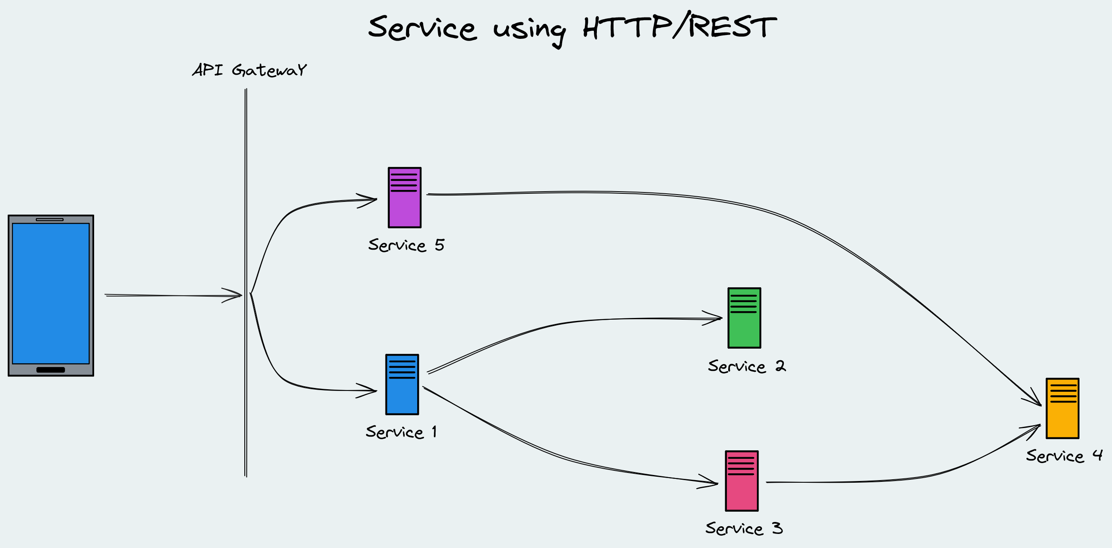
Why message-based systems?

Slide 7

Why message-based systems?

Slide 8

Why message-based systems?

Slide 9
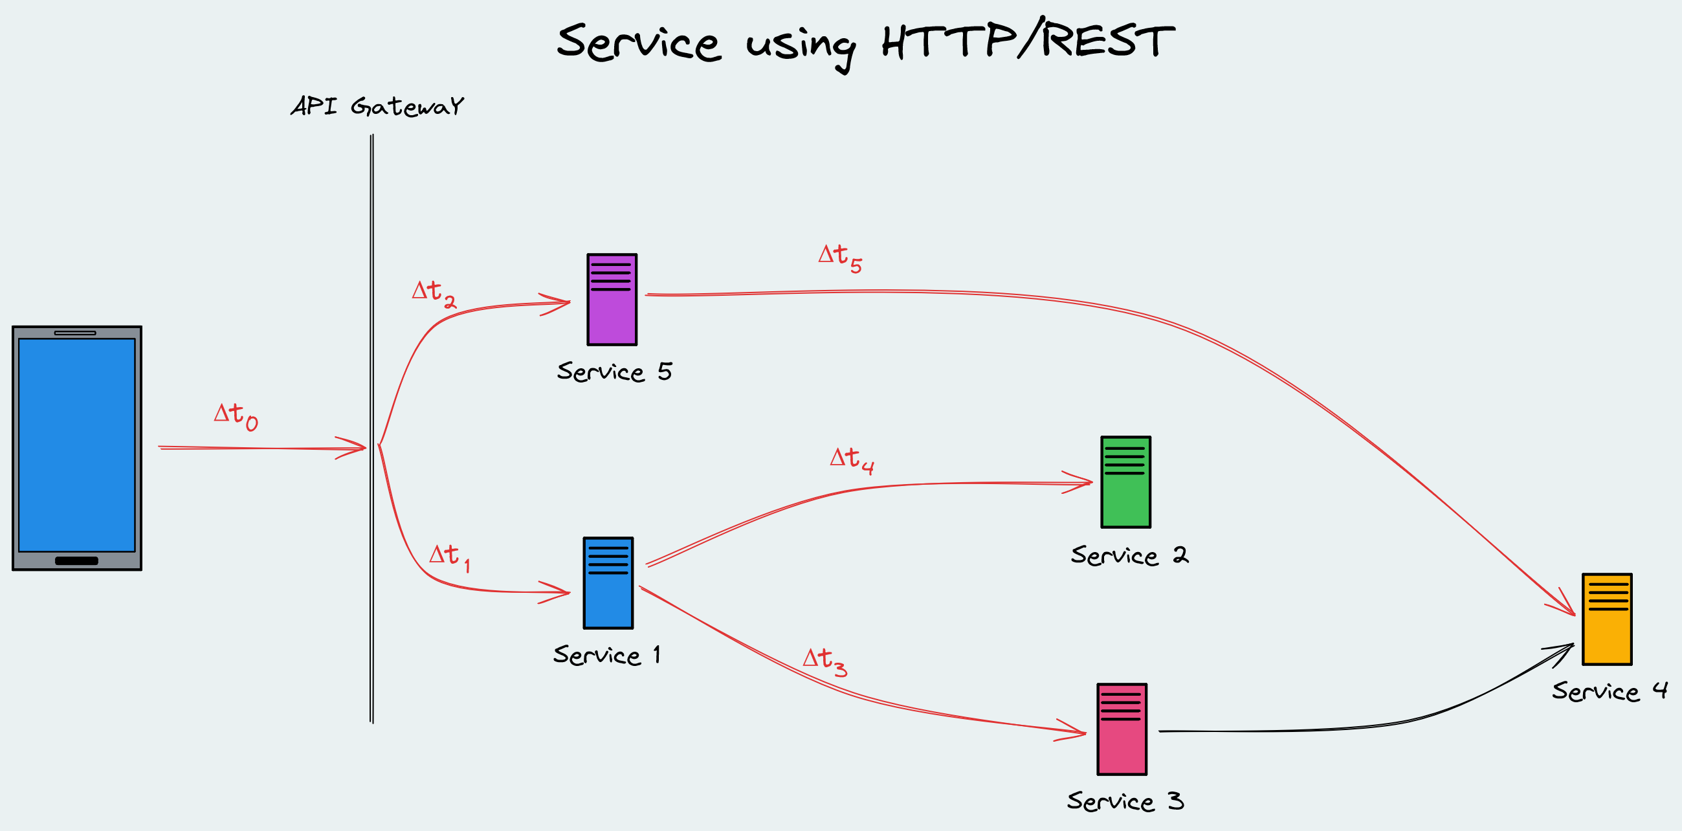
Why message-based systems?

Slide 10
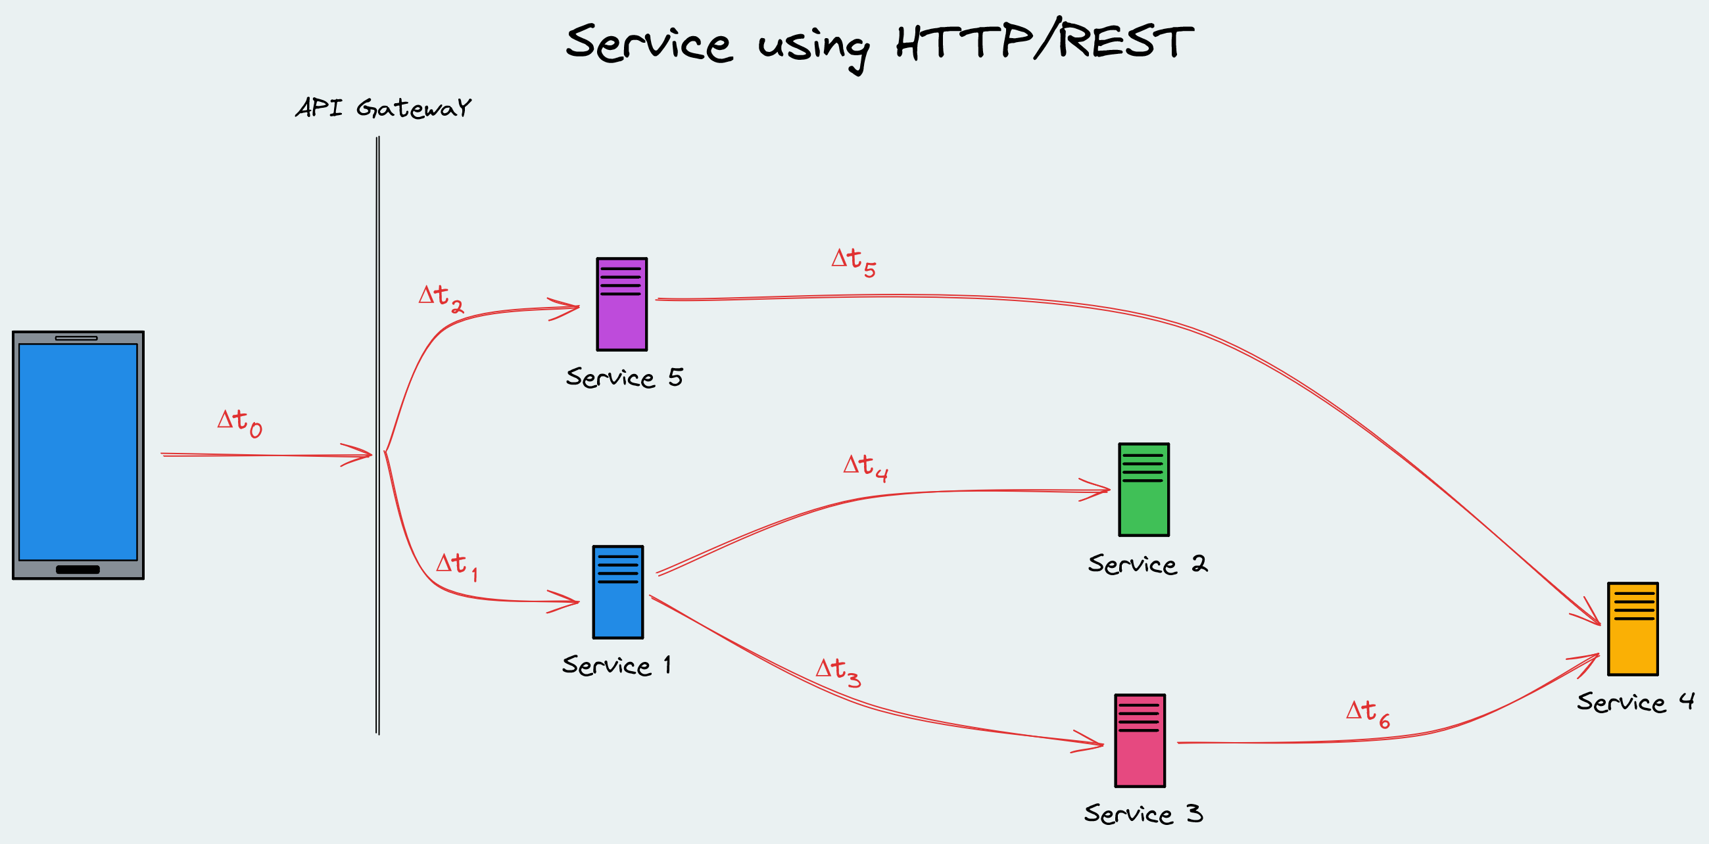
Why message-based systems?

Slide 11

Why message-based systems?

Slide 12
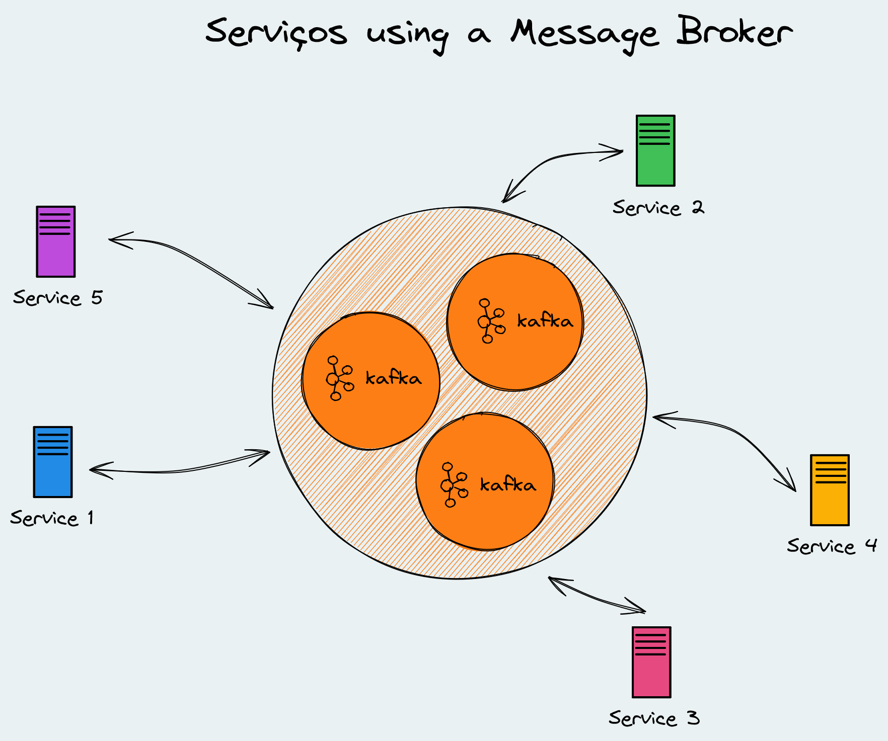
Why message-based systems?

Slide 13
Why message-based systems?
Reduce dependencies on other systems
Distributed message bus
No Single Point of Failure
Asynchronous processing

Slide 14
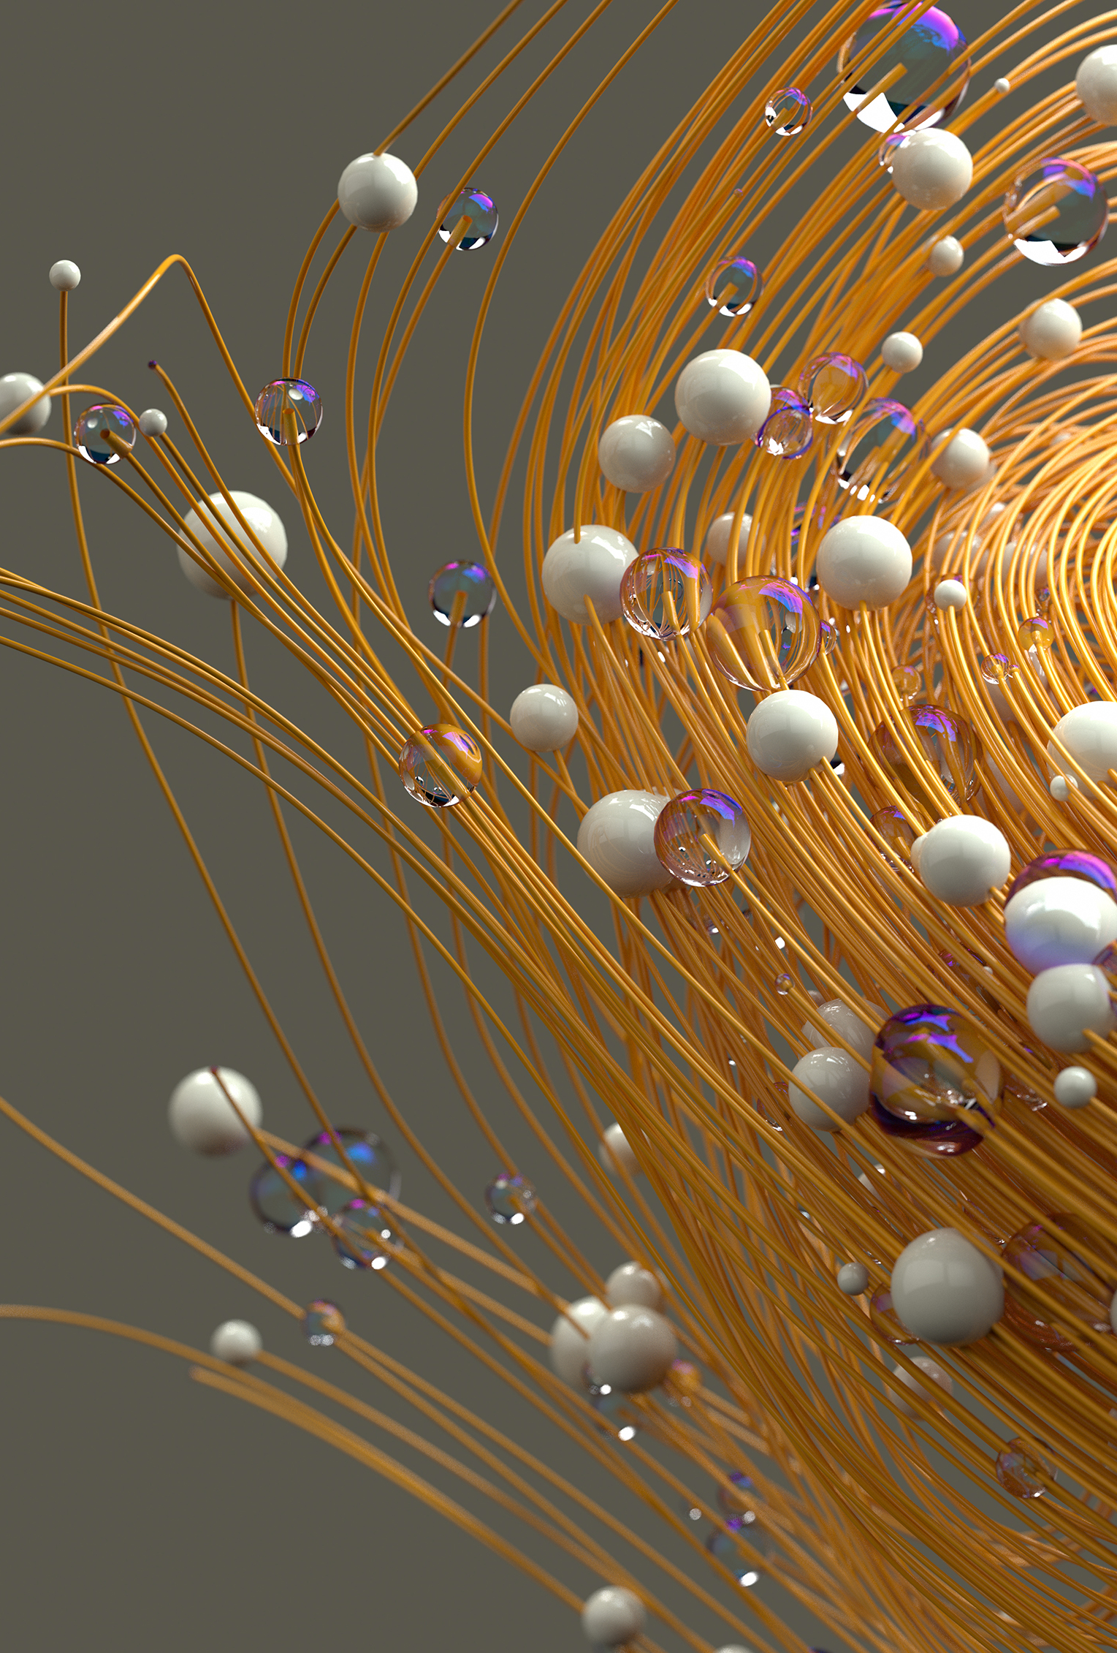
What is system modelling?

Slide 15
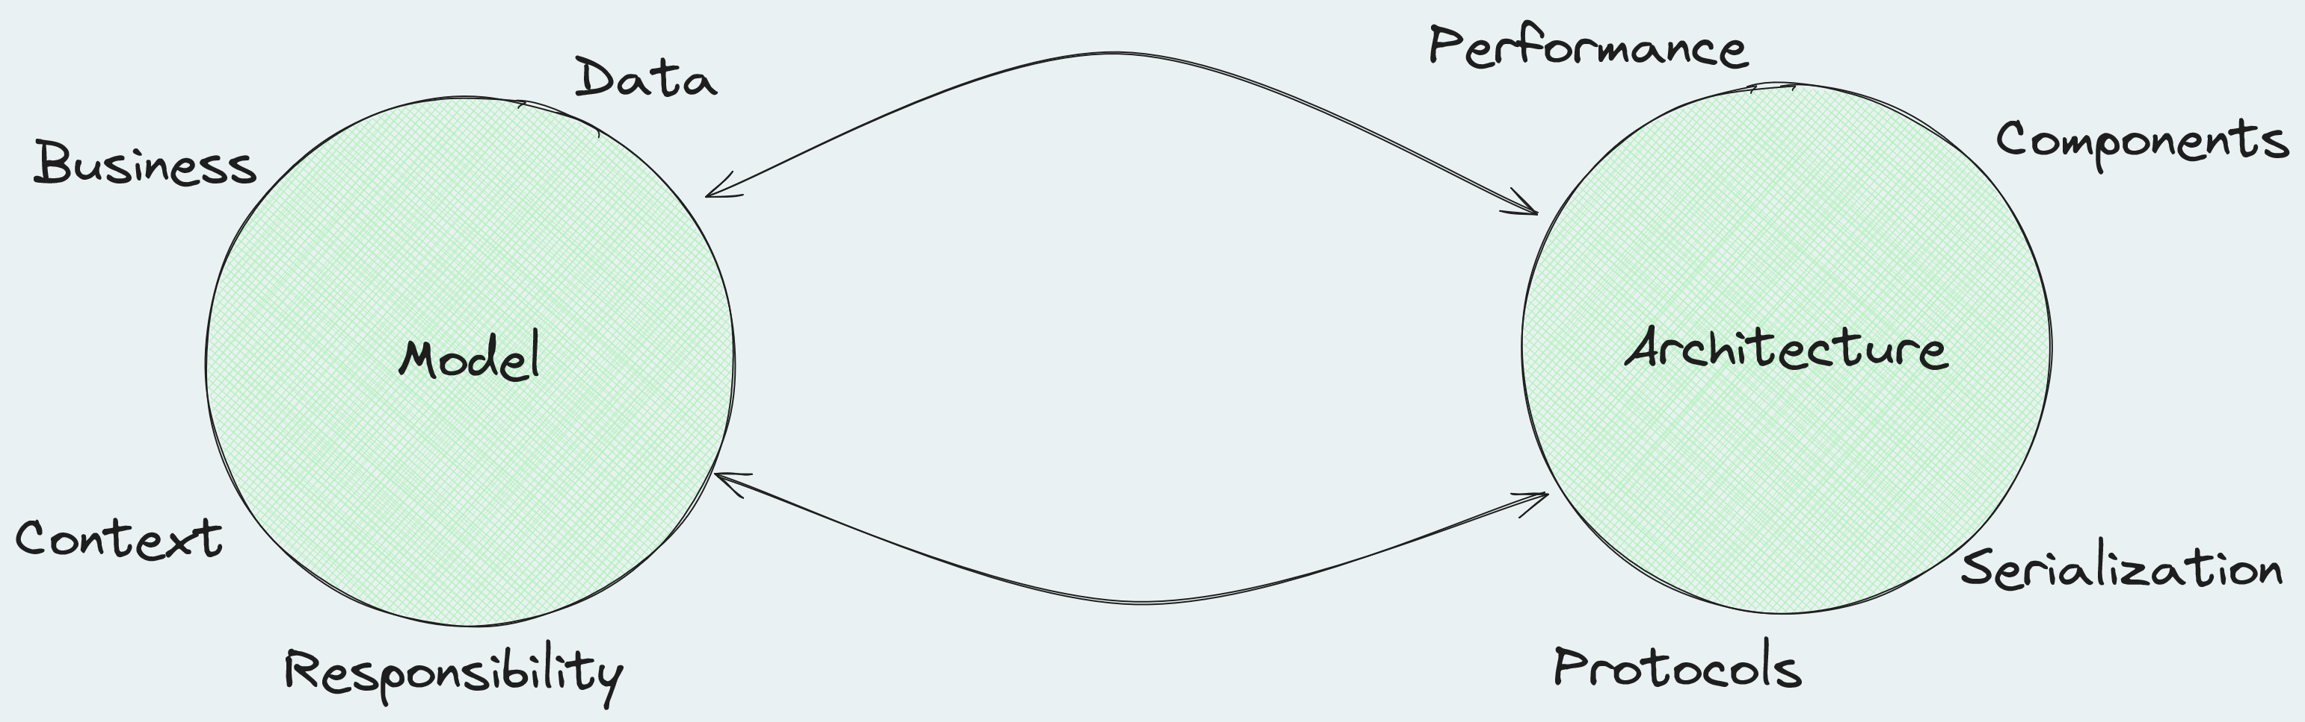
Model x Architecture

Slide 16

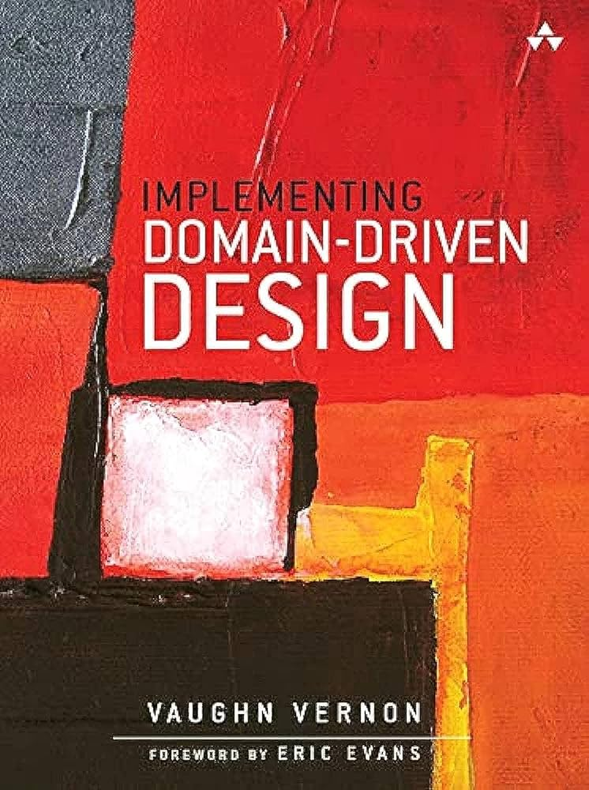
References about modelling
Domain-Driven Design

Slide 17
Modelling
Modelling will be responsible for defining whether a process is synchronous or asynchronous.
Define
Funcionaltities
Behavior
Reponsibilities!
Focused
Domain

Slide 18

How to model a system?

Slide 19
How to model a system?
Building Blocks
Concept
Ubiquitous Language
Entities
Value Objects
Relationship
Aggregates
Services
Repositories
Events
Model
Context
Bounded Context

Slide 20
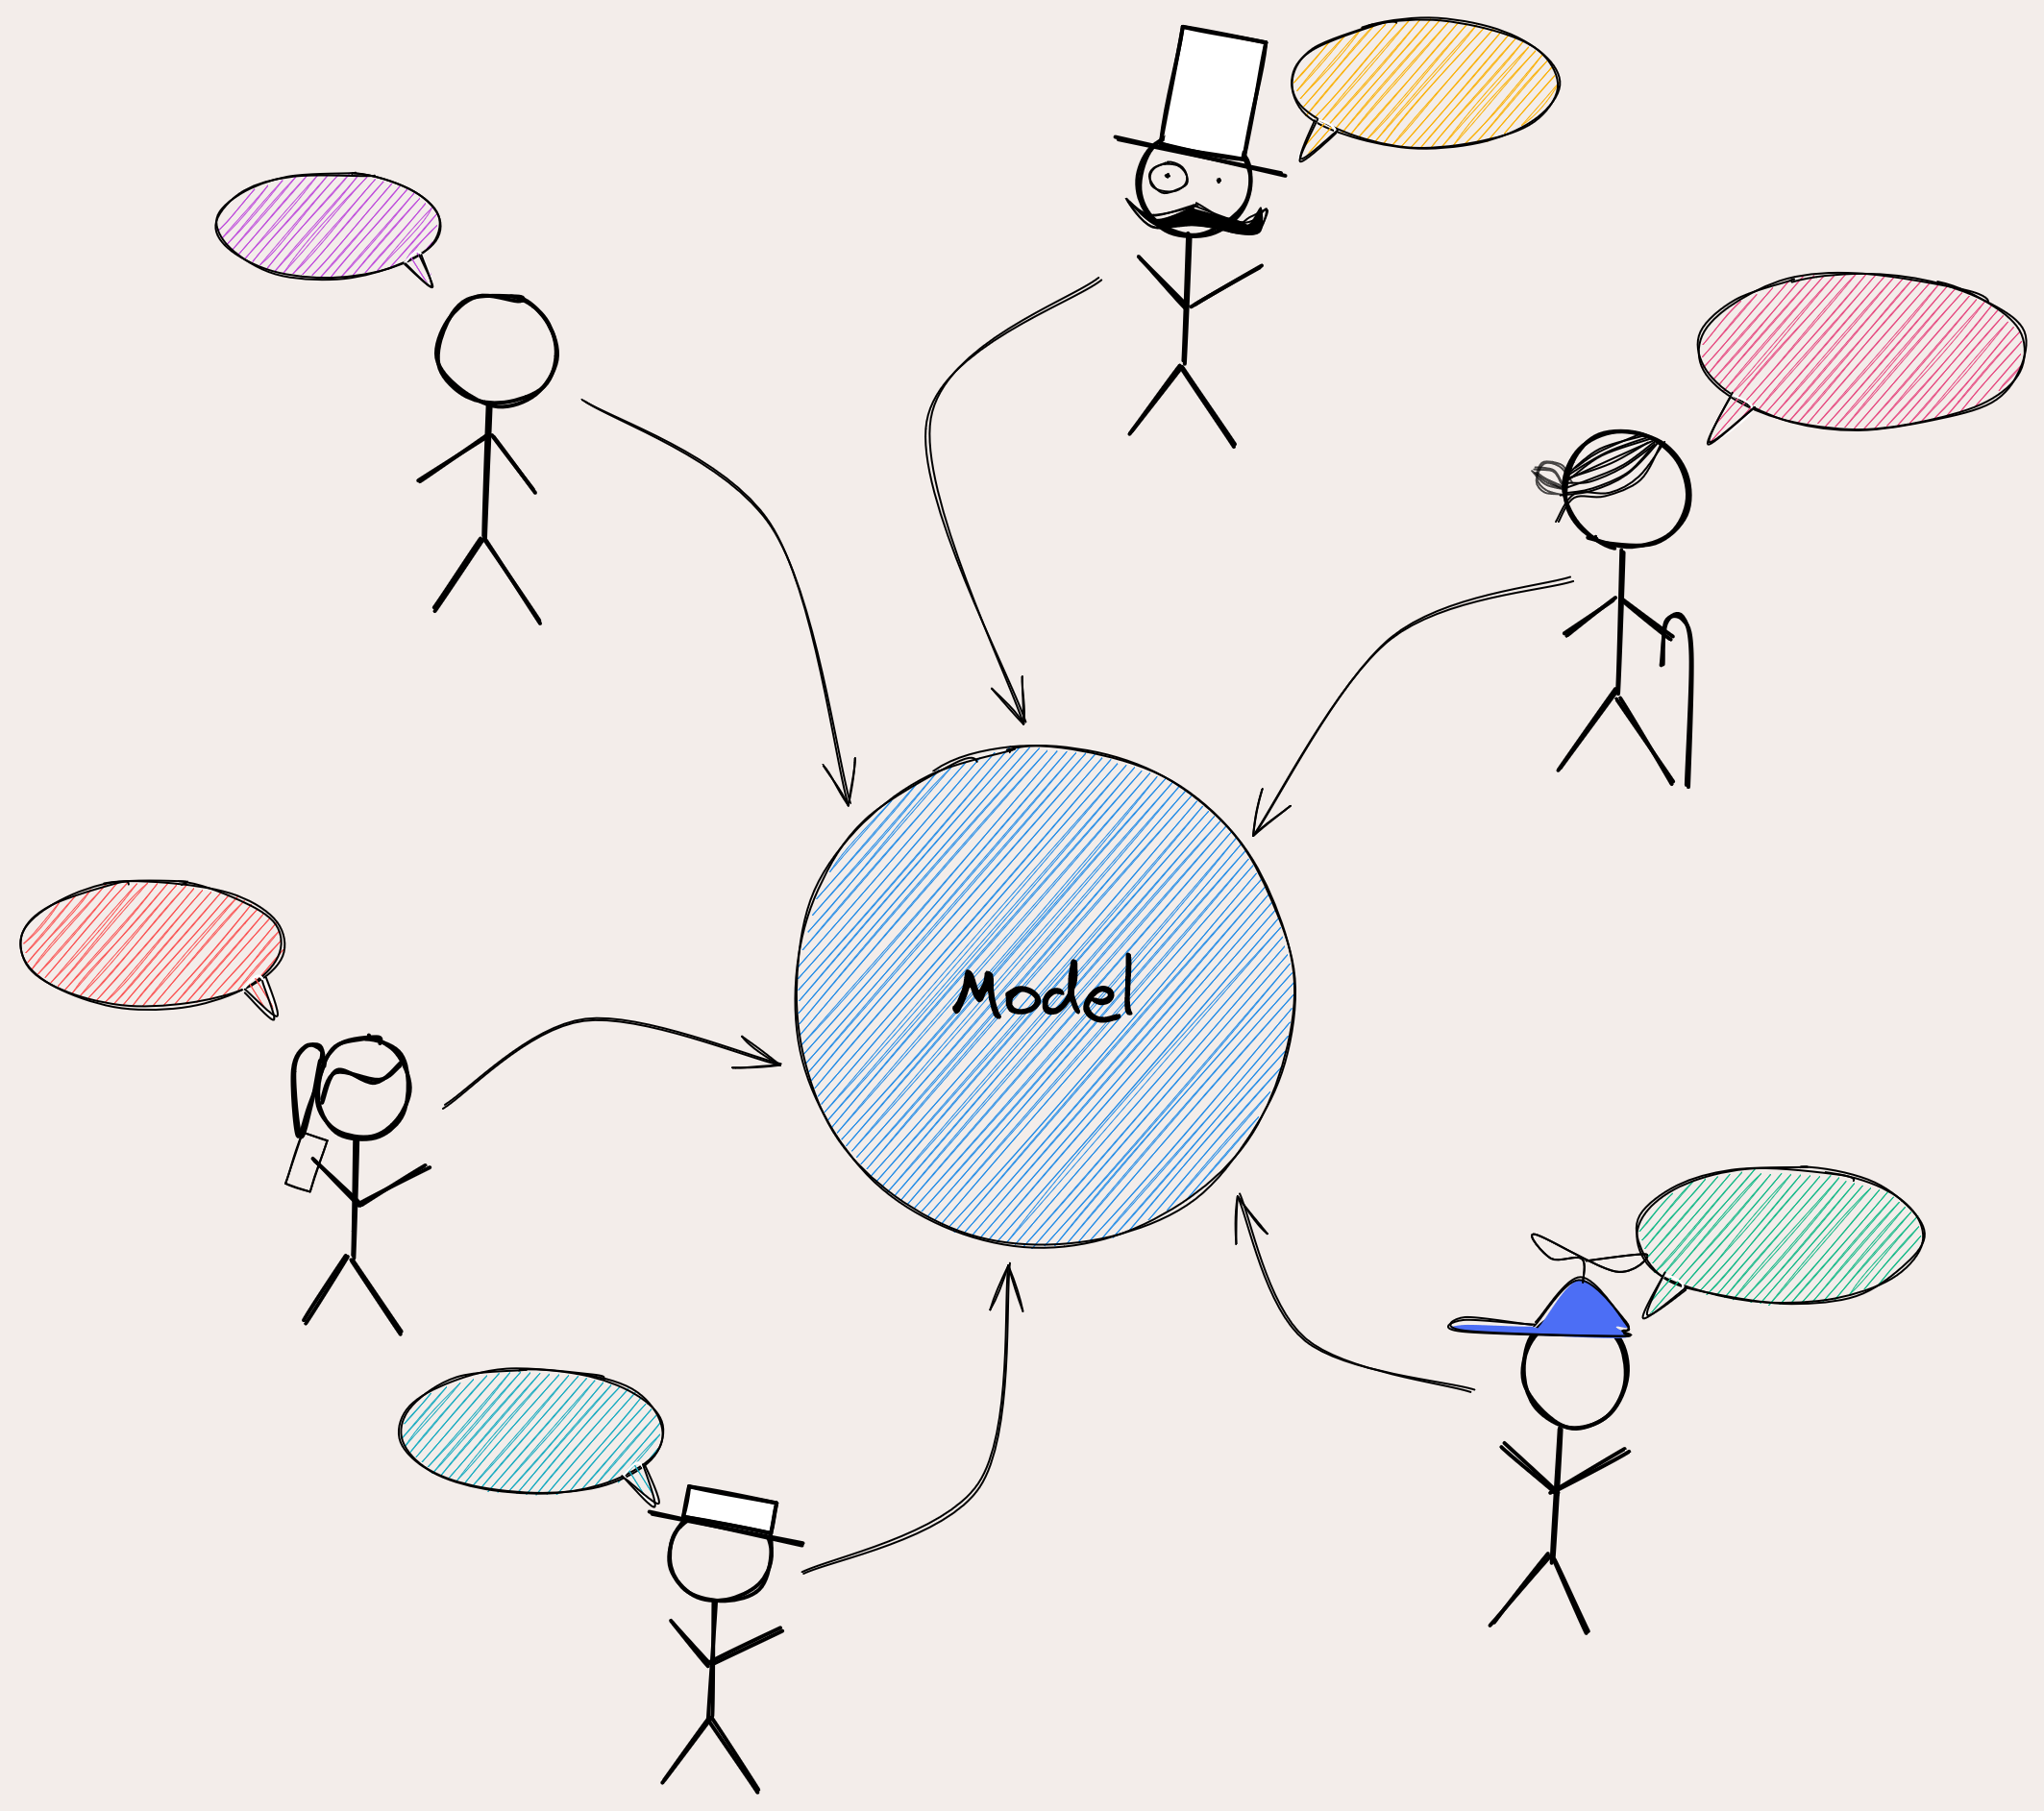
How to model a system?
Model arises from dialogue between everyone involved in the projecto

Slide 21
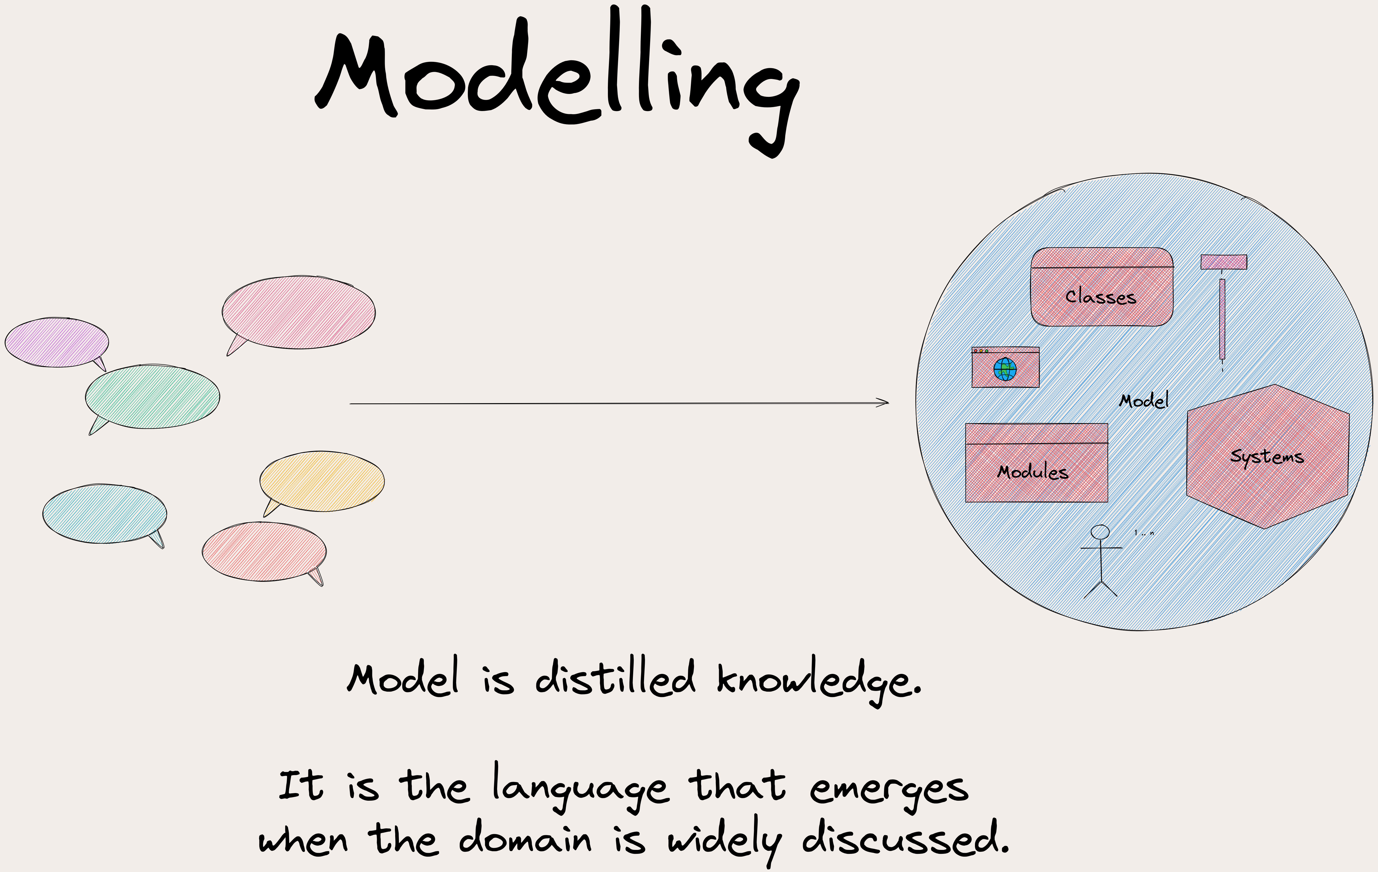
How to model a system?
Model is knowledge project distilled and the code must contain it

Slide 22
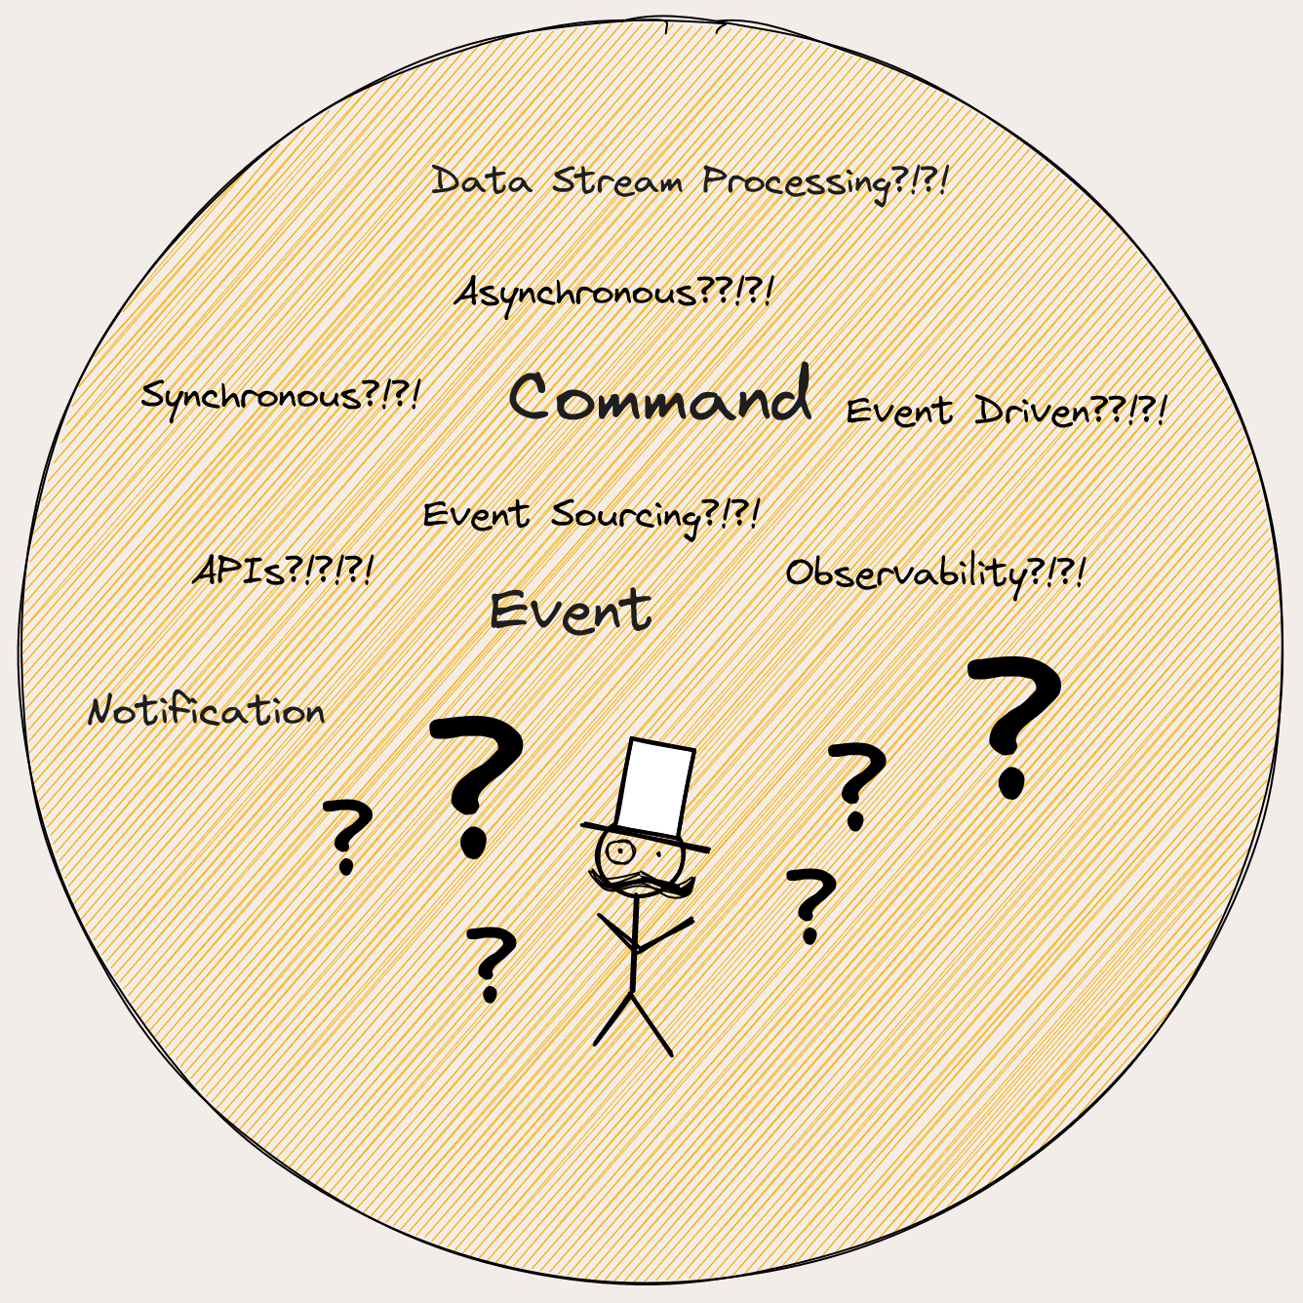
How to model a system?
Communication
Synchronous
Asynchronous
Services Processes
Events

Slide 23
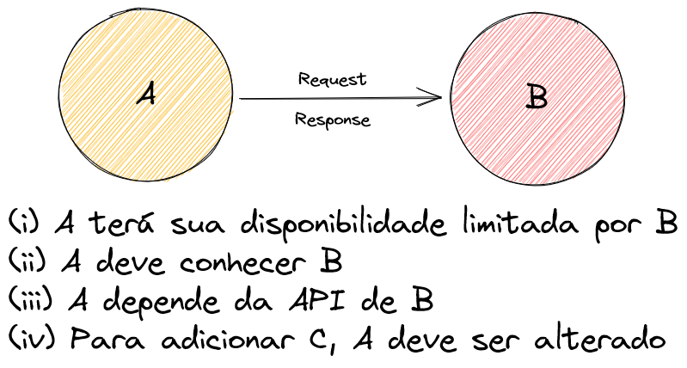
Tipo de Comunicação
API
Request
Response
Fonte: https://excalidraw.com/#json=ow3--huoerWpG0Wy2obTp,p5x9e7UKIlwpvdIeOhqo9Q

Slide 24
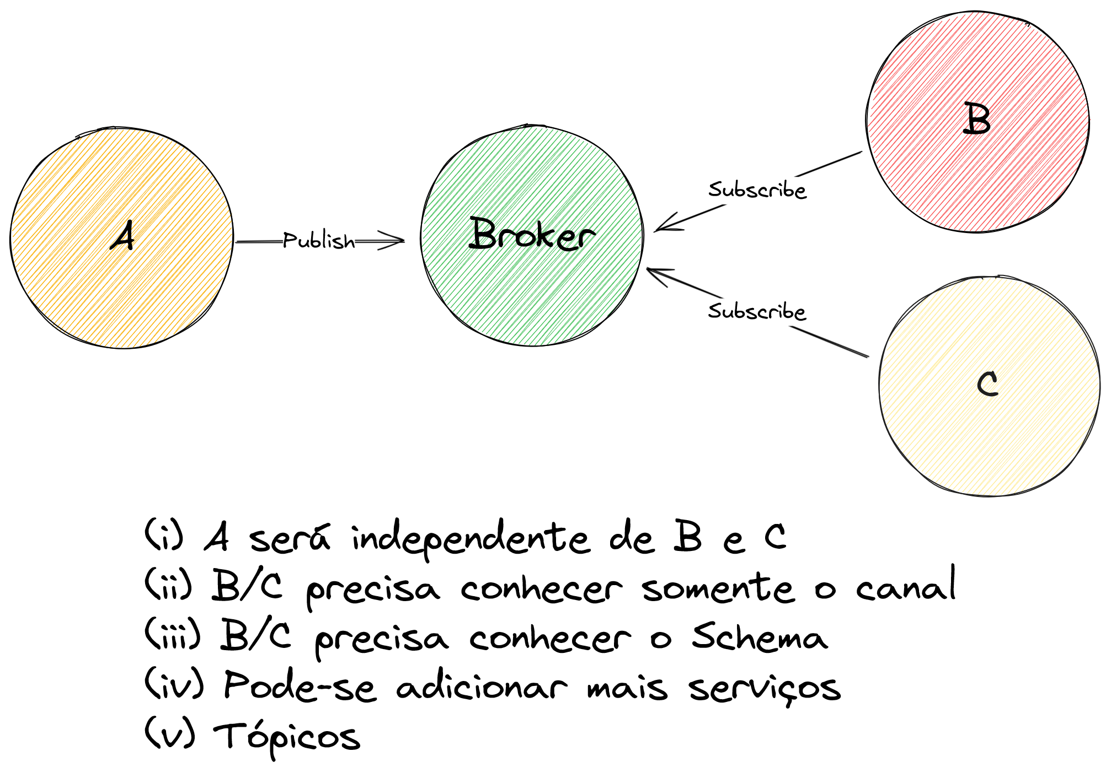
Tipo de Comunicação
Publish/Subscribe
Event-Driven
Tópicos
Broker
Fonte: https://excalidraw.com/#json=Lg8ouE7XyfaxQ5RG8vPv8,VFpbRLDd9tVF-VNNHwFynA

Slide 25
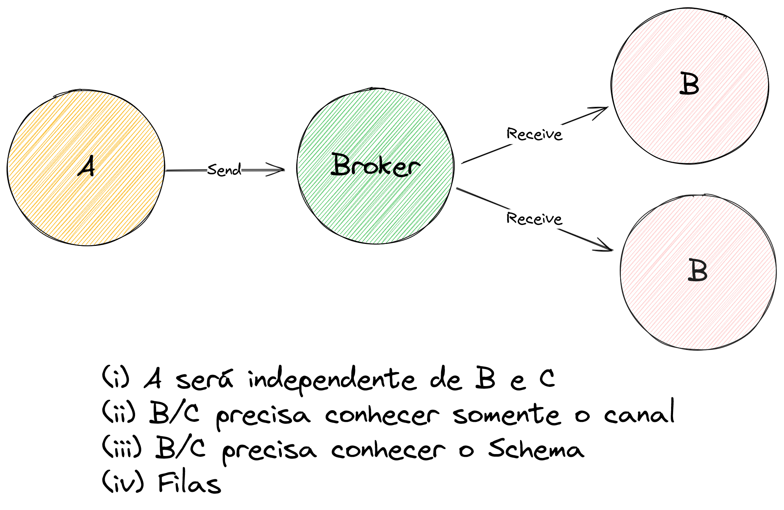
Tipo de Comunicação
Point-to-Point
Processamento assíncrono
Queue
Fonte: https://excalidraw.com/#json=rKQwrCKDSP3PIdLc5RLld,r452rEXanIdMpCYcQE_Irw

Slide 26
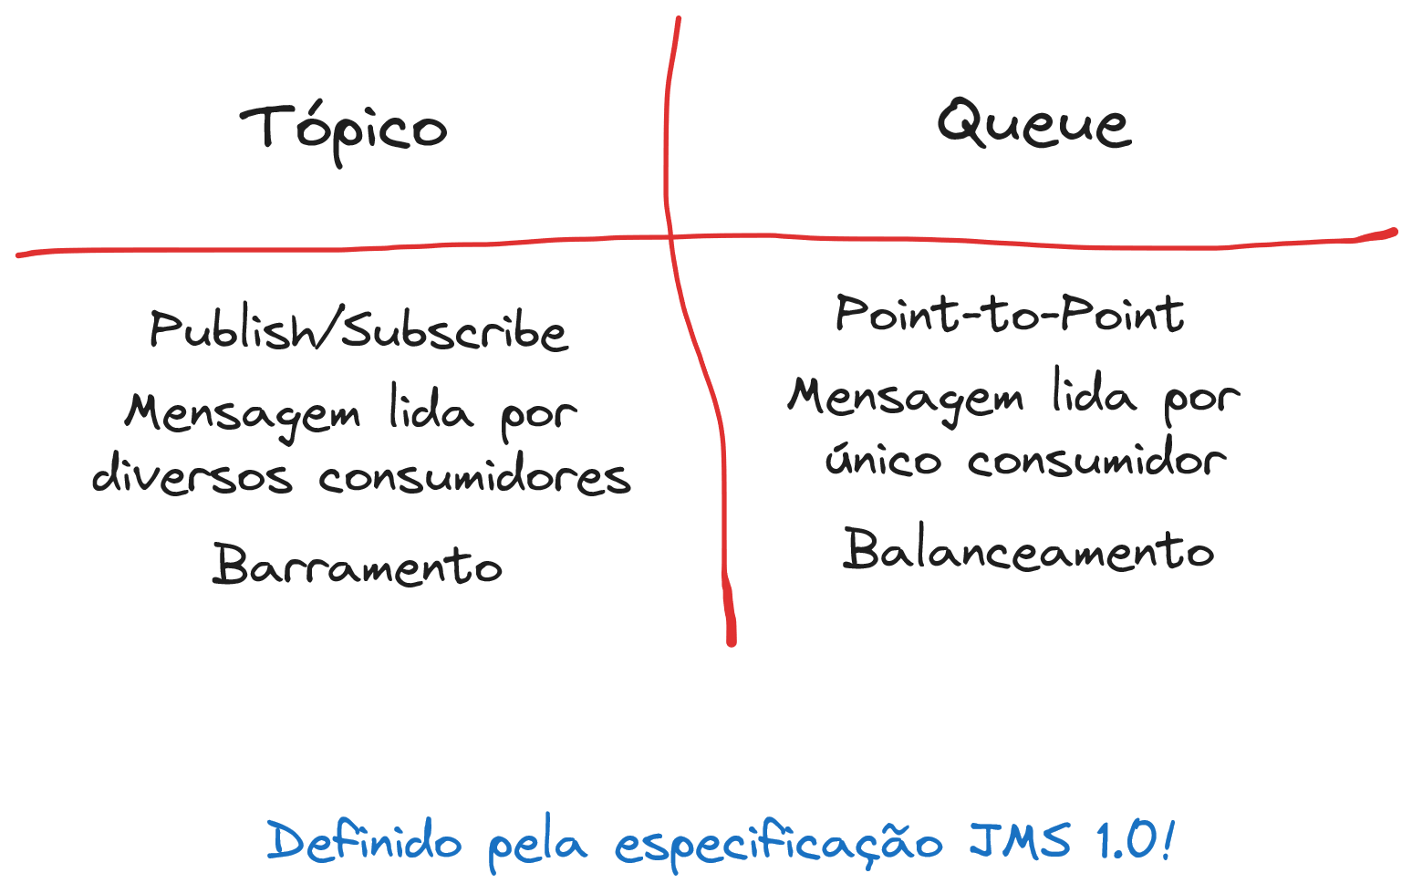
Tópico vs Queue

Slide 27
Tipos de comunicação
Todas as formas de comunicação podem coexistir!
Tudo é uma escolha de design e TRADE-OFF

Slide 28
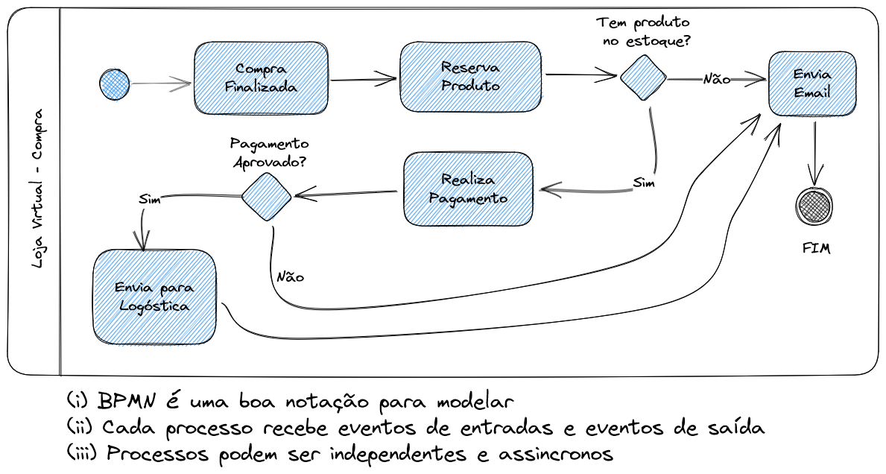
É preciso redefinir processos
Fonte: https://excalidraw.com/#json=RZxJK6tX-2FdvQdES_M86,CLt1AE7rqU90__-u2KKPoA

Slide 29
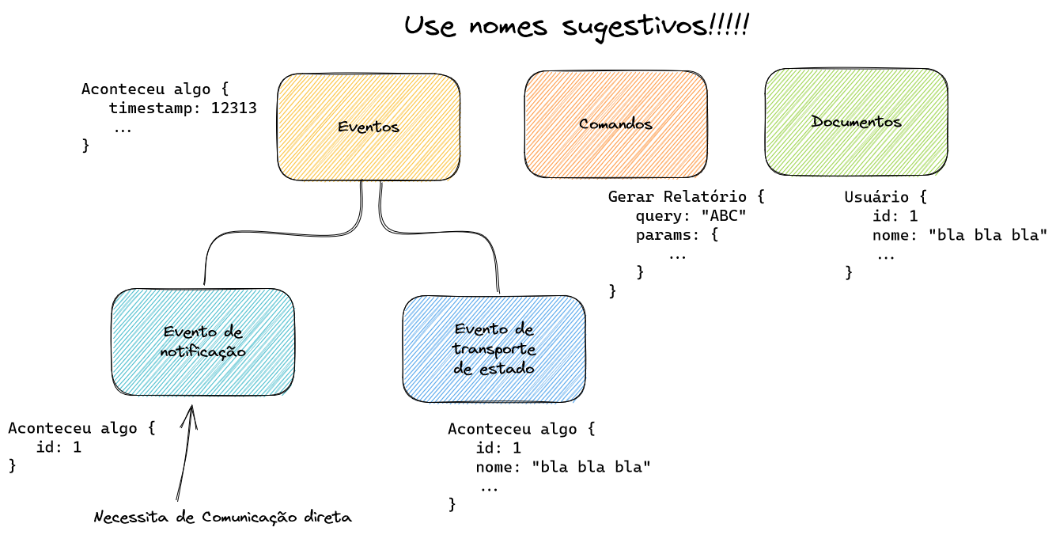
Tipos de Eventos

Slide 30

Tipos de Eventos
Cada evento deve ter seu nome e Schema bem definido
Times devem conhecer o nome e Schema
Nomes devem ser bem descritivos
UsuarioCriado
UsuarioAlterado
FecharCarrinho
AdicionarProdutor

Slide 31
Tipos de Sistemas
Arquitetura Event-Driven
Sistemas se comunicam através de notificações
Arquitetura Event-Sourcing
Eventos são a fonte principal de verdade
Eventos são fortemente ordenados
Data Stream Processing
Dados são processados continuamente
Time Series
Dados analógicos
Sensores

Slide 32
Tipos de Sistemas
Arquitetura Event-Driven
Sistemas se comunicam através de notificações
Arquitetura Event-Sourcing
Eventos são a fonte principal de verdade
Eventos são fortemente ordenados
Data Stream Processing
Dados são processados continuamente
Time Series
Dados analógicos
Sensores
Outra conversa!

Slide 33

Obrigado
Victor Osório
@vepo
https://www.youtube.com/@victor.osorio
https://blog.vepo.dev/

